Slide 1

IEEE B-HTC 2023
“Mobile Air Pollution Monitoring & Vehicle Tracking” for Metropolitan Ares Using Internet of Things and ThingSpeak Cloud
R Deepak Reddy N V V Ramana Reddy K Manohar Reddy P Sai Karthika Vijaya Bhasker Reddy | Electronics and Communication Engineering KG Reddy College of Engineering & Technology Hyderabad, Telangana, India

Slide 2
IEEE B-HTC 2023
Bangalore Humanitarian Technology Conference
Co-organized & Hosted by
JSS Academy of Higher Education & Research
&
JSS Medical College, Mysuru

Slide 3
Contents
Abstract
Introduction
Problem Definition
Methodology
Results
Conclusion
References

Slide 4
Abstract
The need for a smart and portable management system which provides us with an efficient practice to monitor air pollution and the current location of the vehicle to help the stakeholders with efficient time management as well as proper monitoring of pollutants around us. Even rural areas are affected by the overall increase in vehicle emissions. So, a system is needed where we can constantly monitor the surrounding pollution levels. Instead of an inert system, we are proposing a more flexible one. With an idea of jointly presenting technology with the requirement of information transmission also, planned for a creative approach to track a vehicle and monitor the pollution levels at the same time using GPS and PM sensors. The system modelled can also be used for Detection of Accident and to Alert people in wide areas of applications such as in tracking college/school buses, Taxis /Cabs, theft vehicles, etc.

Slide 5
Introduction
Nowadays, the increase in harmful gases in the atmosphere is causing damage to human life.
The primary aim of this project is to monitor air pollution levels in the environment and also track the location of the bus through a mobile application.
Through an android application, we can track the current status of the bus, monitoring the air pollution levels and updating the status of those to the nearest corresponding departments.
With this, the end users get an awareness on the pollution levels in their surroundings and also at multiple places.

Slide 6
Problem Definition
The air pollution is one of the major environmental issues that cannot be ignored. Inhaling pollutants for a long time causes damage to human health. The different areas maintain different levels of air quality at different times and it is important for us to monitor what is happening. That way we can identify trouble spots and ensure that we are taking the right steps. Our application will be helpful to students, faculty, travellers, elderly people and pollution control board etc.

Slide 7
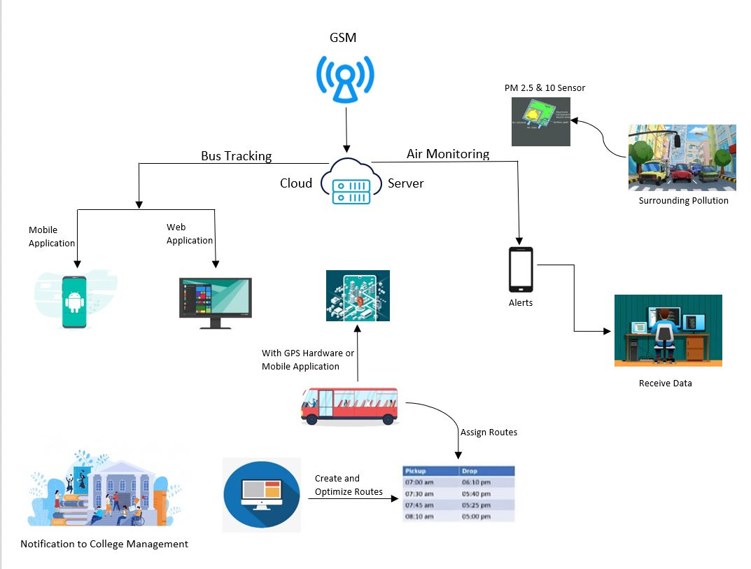
Proposed Method

Slide 8
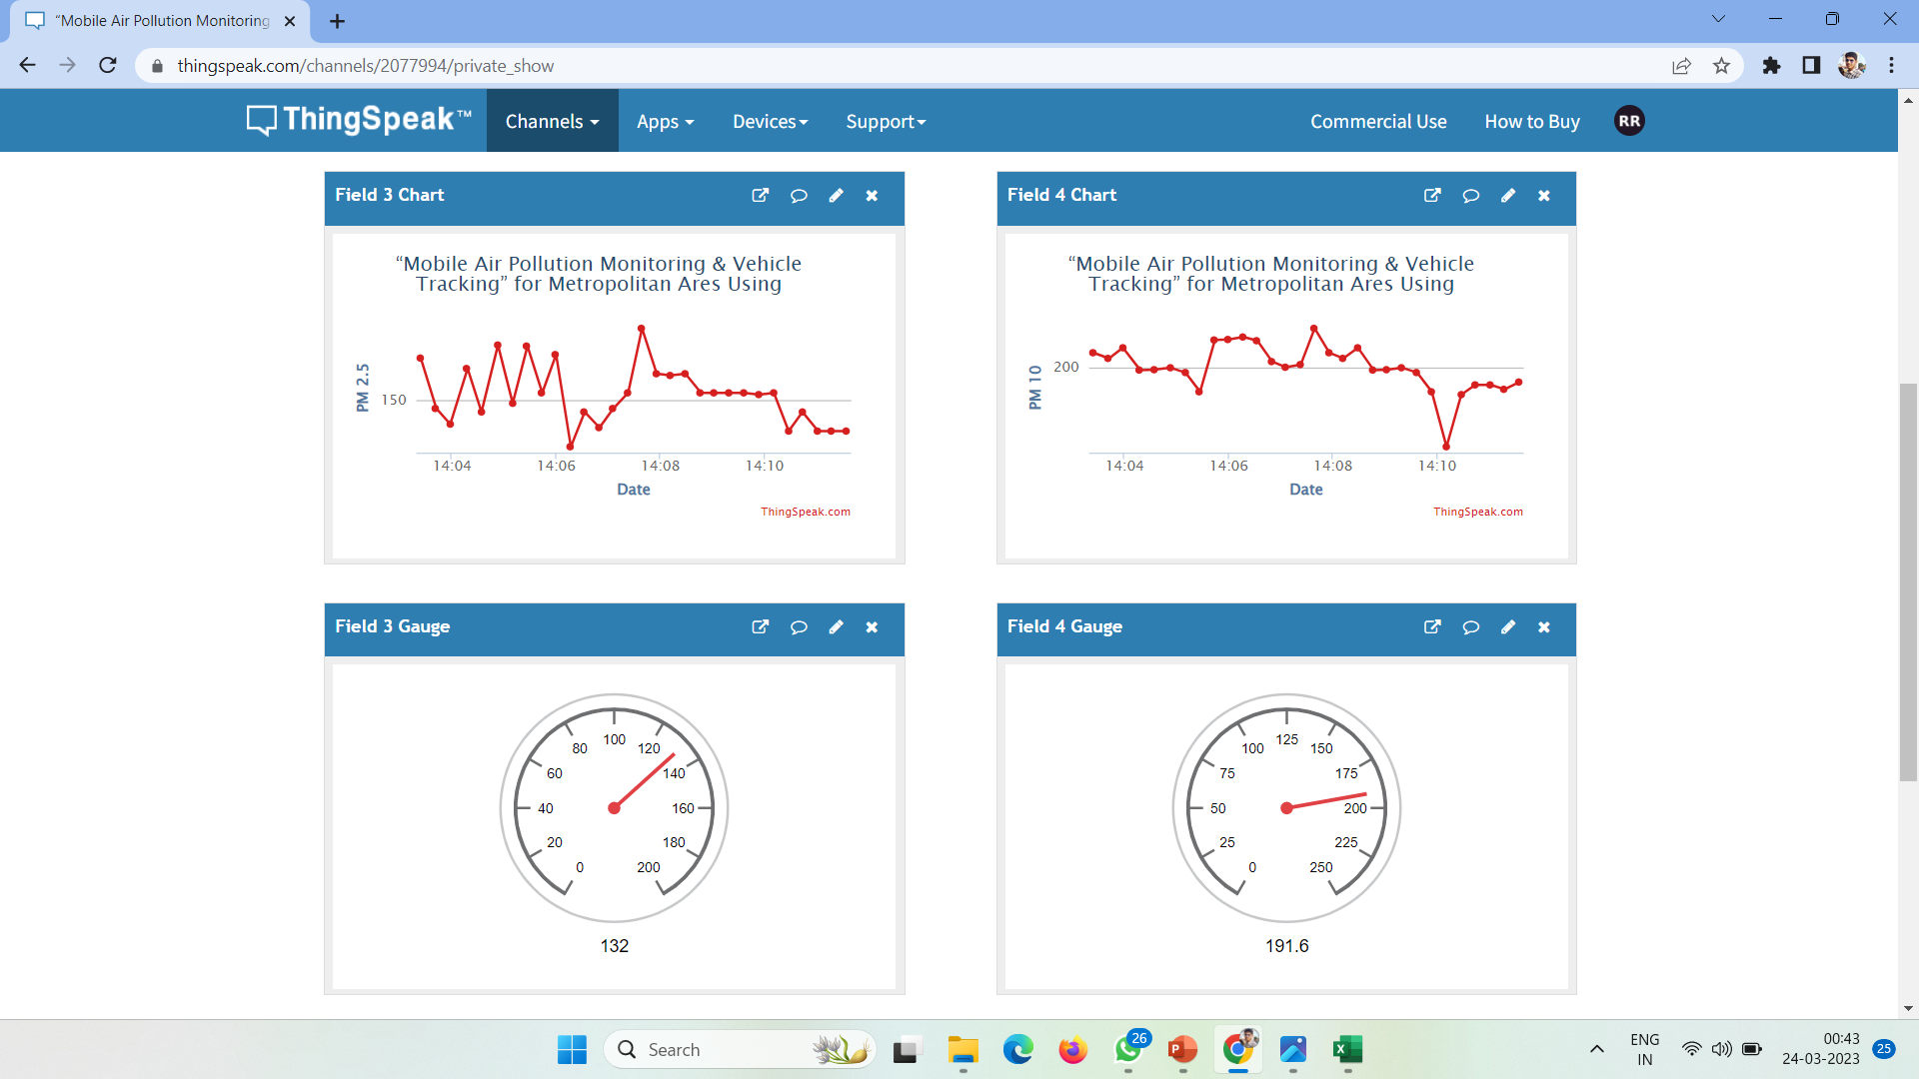

Slide 9
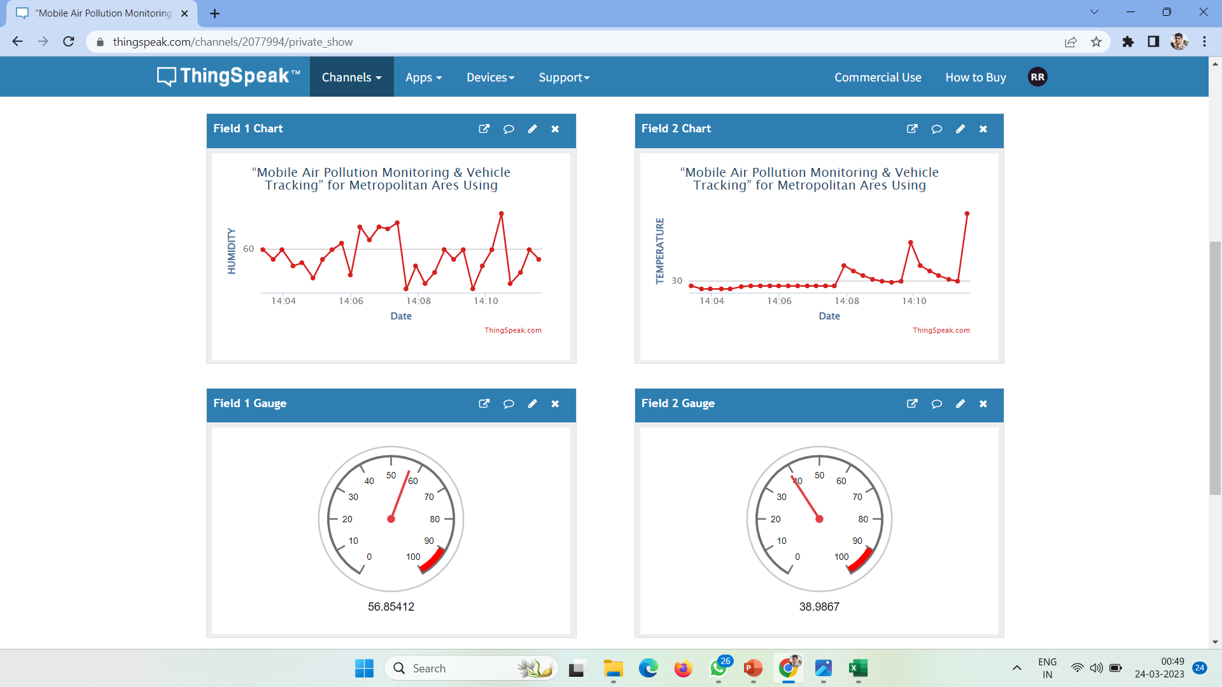
Experimental Results

Slide 10
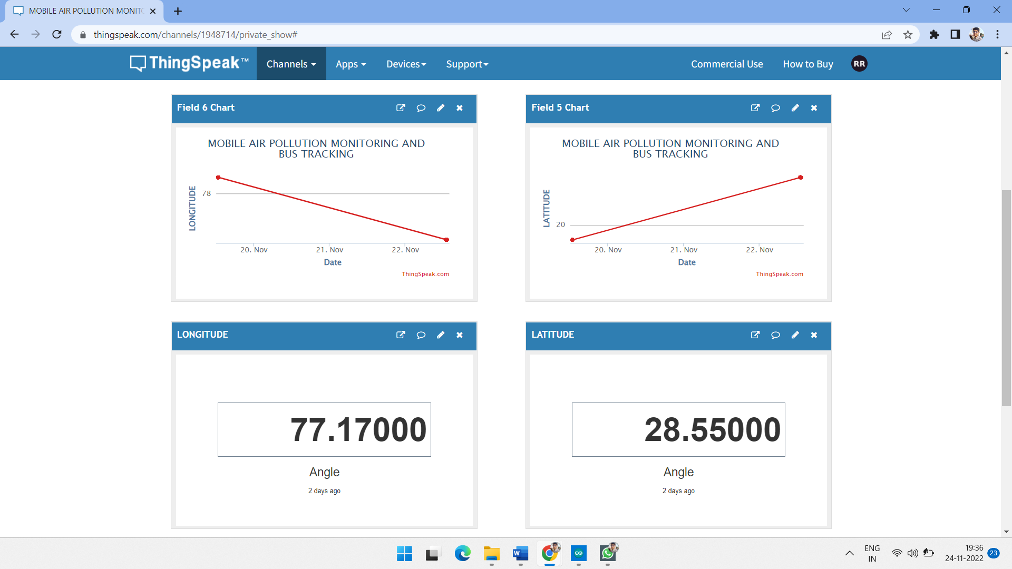
Experimental Results

Slide 11
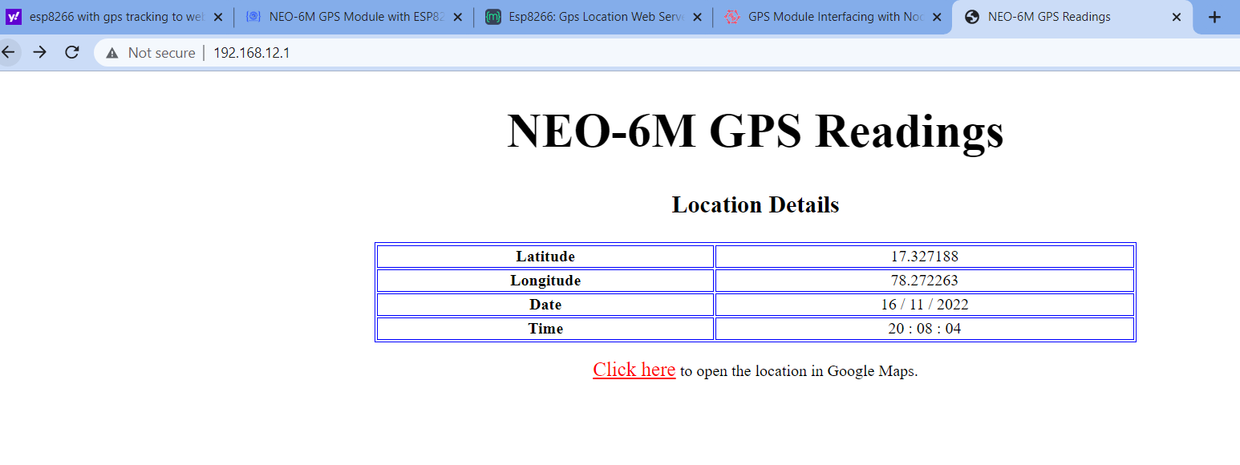
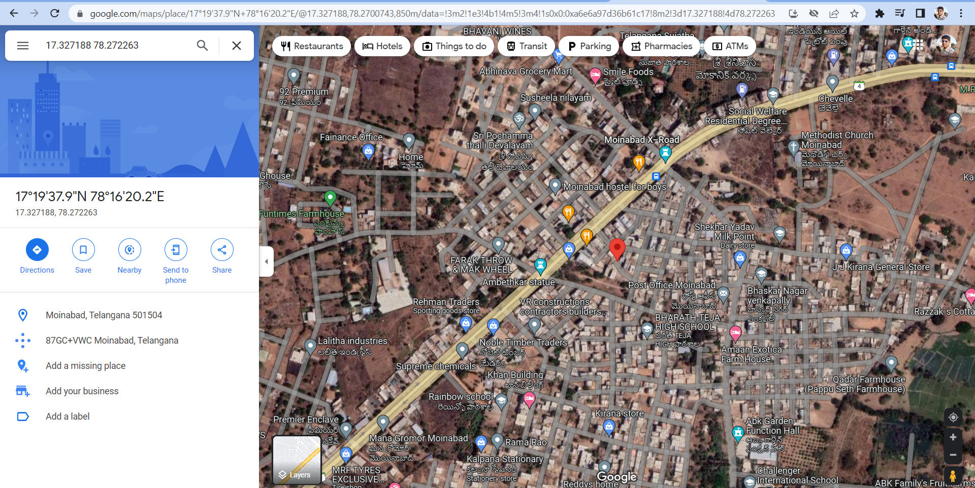
Experimental Results

Slide 12
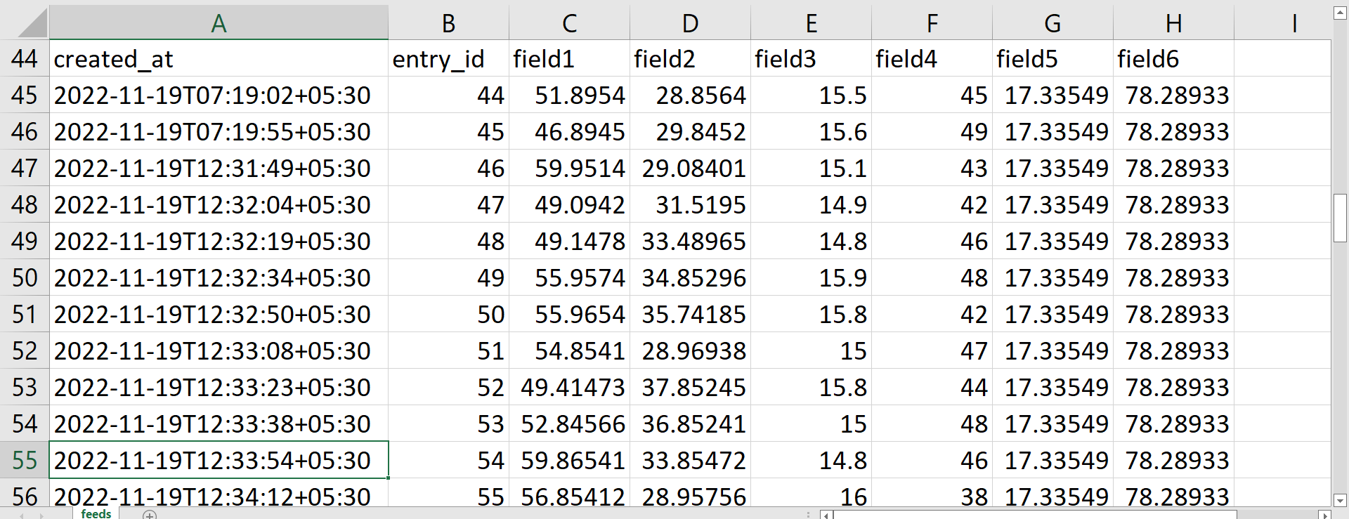
Experimental Results

Slide 13
Conclusion
The titled work, “MOBILE AIR POLLUTION MONITORING AND VEHICLE TRACKING” is a model for monitoring the level of air pollutants at different areas and time intervals, while also identifying the trouble spots by using a GPS receiver and GSM modem. Vehicle tracking both in case of personal as well as business purpose improves safety and security, communication medium, performance monitoring and increases productivity. So, in the coming years, it is going to play a major role in our day-to-day living.

Slide 14
References
[1] P. Das, S. Ghosh, S. Chatterjee and S. De, "A Low-Cost Outdoor Air Pollution Monitoring Device With Power Controlled Built-In PM Sensor," in IEEE Sensors Journal, vol. 22, no. 13, pp. 13682-13695, 1 July1, 2022, doi: 10.1109/JSEN.2022.3175821.
[2] M. F. M. A. Hakeem, N. A. Sulaiman, M. Kassim and N. M. Isa, "IoT Bus Monitoring System via Mobile Application," 2022 IEEE International Conference on Automatic Control and Intelligent Systems (I2CACIS), 2022, pp. 125-130, doi: 10.1109/I2CACIS54679.2022.9815268.
[3] B. B. Humaïra and A. Chiniah, "An Adaptive Communication Model for Android Bus Tracking App," 2021 2nd Global Conference for Advancement in Technology (GCAT), 2021, pp. 1-6, doi: 10.1109/GCAT52182.2021.9587657.
[4] T. W. Ayele and R. Mehta, "Air pollution monitoring and prediction using IoT," 2018 Second International Conference on Inventive Communication and Computational Technologies (ICICCT), 2018, pp. 1741-1745, doi: 10.1109/ICICCT.2018.8473272.
[5] V. Shakhov and O. Sokolova, "On Modeling Air Pollution Detection With Internet of Vehicles," 2021 15th International Conference on Ubiquitous Information Management and Communication (IMCOM), 2021, pp. 1-3, doi: 10.1109/IMCOM51814.2021.9377350.
[6] R. S. Krishnan, S. Manikandan, J. R. F. Raj, K. L. Narayanan and Y. H. Robinson, "Android Application based Smart Bus Transportation System for Pandemic Situations," 2021 Third International Conference on Intelligent Communication Technologies and Virtual Mobile Networks (ICICV), 2021, pp. 938-942, doi: 10.1109/ICICV50876.2021.9388625.
[7] H. Gull, D. Aljohar, R. Alutaibi, D. Alqahtani, M. Alarfaj and R. Alqahtani, "Smart School Bus Tracking: Requirements and Design of an IoT based School Bus Tracking System," 2021 5th International Conference on Trends in Electronics and Informatics (ICOEI), 2021, pp. 388-394, doi: 10.1109/ICOEI51242.2021.9452818.
[8] S. A. E. Yosif, M. M. Abdelwahab, M. Abd Elrahman ALagab and F. Muhammad, "Design of bus tracking and fuel monitoring system," 2017 International Conference on Communication, Control, Computing and Electronics Engineering (ICCCCEE), 2017, pp. 1-5, doi: 10.1109/ICCCCEE.2017.7867679.

Slide 15
THANK YOU

